Slide 1
CSE 428
Project Milestone-2
Group 1 (sec 2):
Ahmed Shakib Reza (ID: 23341130)
Kazi Mahathir Rahman (ID: 23341066)
Md. Abrar Hasan (ID: 23241115)
Mahmud Abedin (ID: 20301366)
Ishmam Azmine (ID: 21301299)
Ronak Karmakar (ID: 18101298)

Slide 2
Data Augmentation
Ronak Karmakar
18101298
1. Determine the Maximum Number of Samples in Any Class:
- The function first calculates the maximum number of samples (`max_sample`) present in any class/sub-folder within the given directory (`folder_path`).
2. Set Up Image Data Augmentation:
- It uses Keras' `ImageDataGenerator` to define a set of image augmentation transformations. These include rotations, width and height shifts, shear transformations, zooming, horizontal flipping, and filling any newly created pixels after a transformation (`fill_mode='nearest'`).
3. Iterate Over Sub-Folders (Classes):
- The function iterates over each sub-folder in the given directory. Each sub-folder is assumed to represent a different class.

Slide 3
Ronak Karmakar
18101298
4. Calculate Augmentation Requirement for Each Class:
- For each class, it calculates how many new augmented images are needed (`augmentation_num`) to match the number of samples in the class with the most samples (`max_sample`).
5. Perform Data Augmentation:
- If augmentation is needed (i.e., `augmentation_num` > 0), it iterates over the images in the class's sub-folder.
- Each image is loaded, converted into a numpy array, and reshaped to fit the requirements of `ImageDataGenerator`.
- The `datagen.flow` method is used to generate augmented images. It saves one augmented image per original image in the same sub-folder with a filename prefix of 'img' and format 'jpeg'. The loop for augmentation breaks after saving one augmented image per original image.
6. Limiting Augmentation:
- The inner loop, which performs the augmentation, is limited to only generate one augmented image per original image (`if i >= 1: break`).

Slide 4
Ahmed Shakib Reza
Id: 23341130
Sec: 02
(AlexNet Model)
(Slide no. 5 to 18)
(in Video: 5:01 to 18:15)

Slide 5
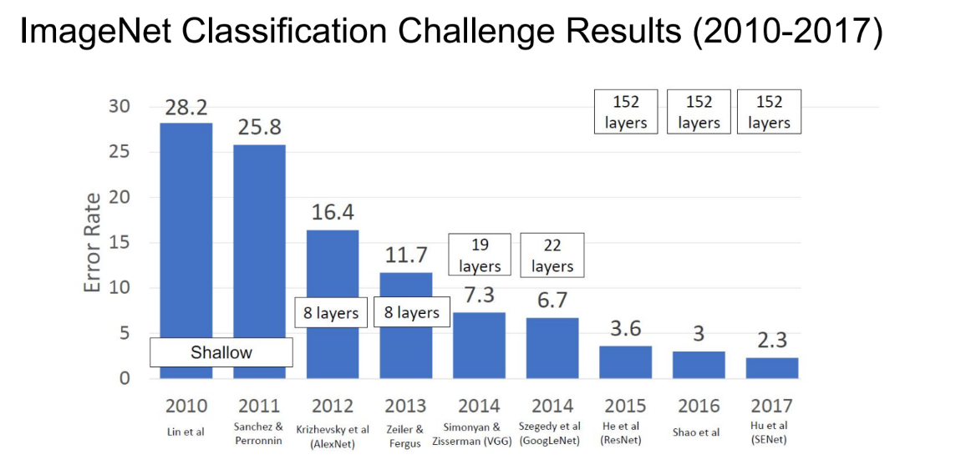
AlexNet
AlexNet was the 1st CNN based model to win ImageNet Challenge in 2012. After this more and more deeper neural networks were proposed, such as VGG, GoogLeNet.

Slide 6
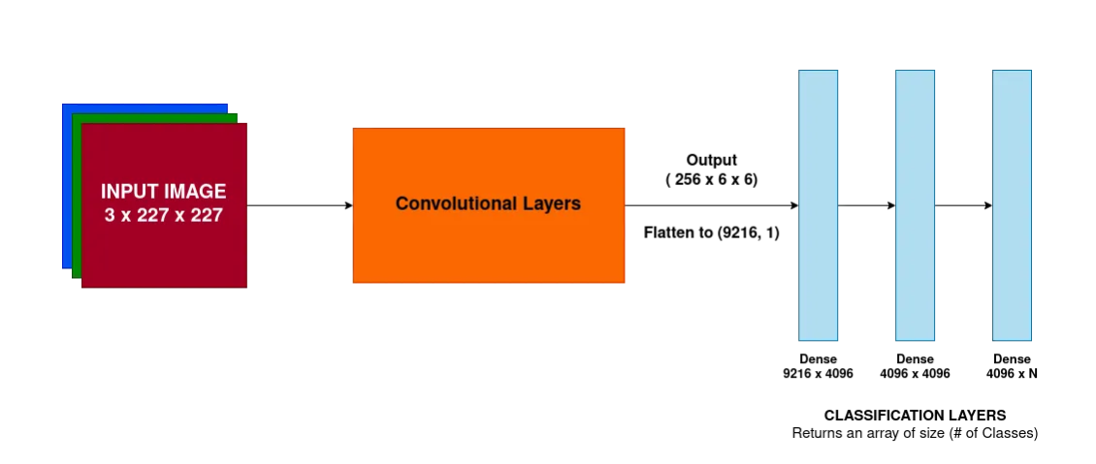
Architecture of AlexNet
Basic Outline of the process

Slide 7
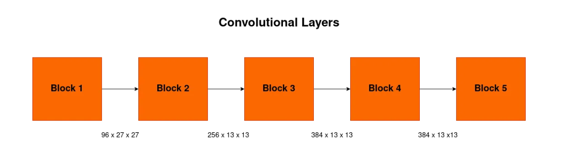
Architecture of AlexNet
If we look into the convolutional layers inside, there are 5 similar blocks, each composed of similar layers.

Slide 8
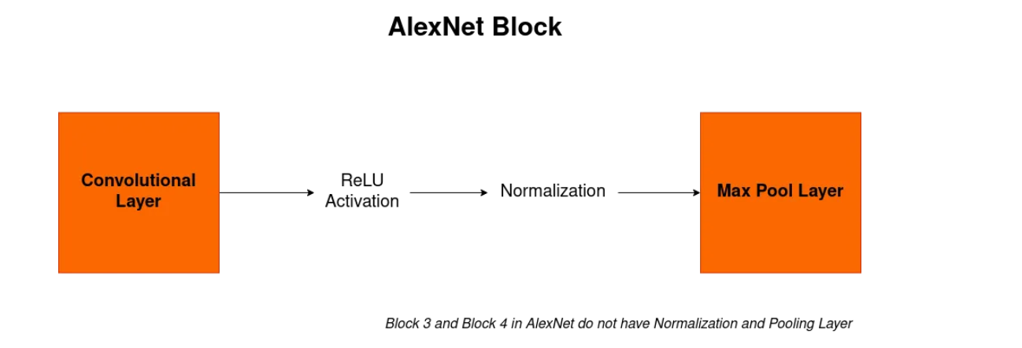
Architecture of AlexNet
Convolutional Block

Slide 9
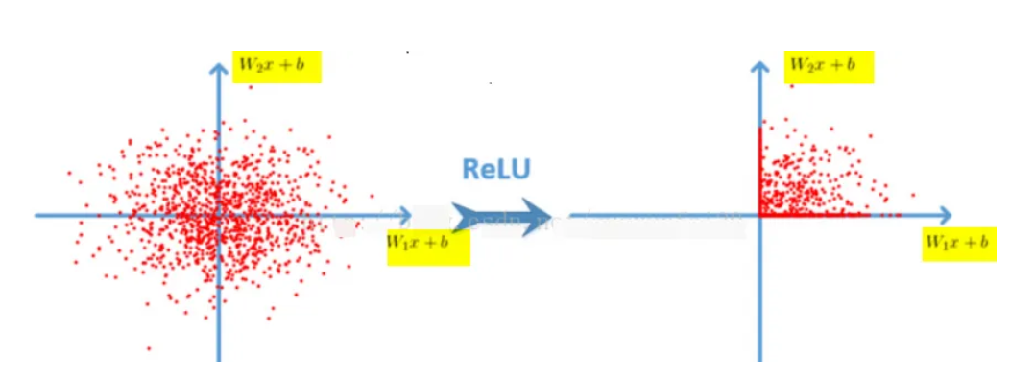
Why does AlexNet achieve better results?
Relu activation function is used: ReLu is used is because it is simple, fast, and empirically it seems to work well
Relu function: f (x) = max (0, x)

Slide 10
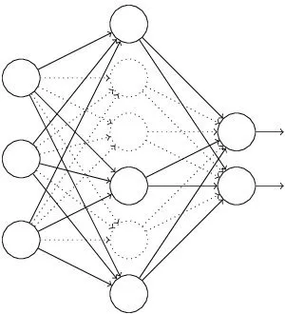
Why does AlexNet achieve better results?
Dropout: Prevents Overfitting

Slide 11
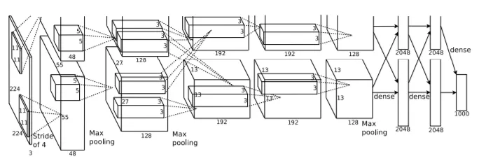
Architecture of AlexNet
Original AlexNet architecture, as given in the research paper.

Slide 12
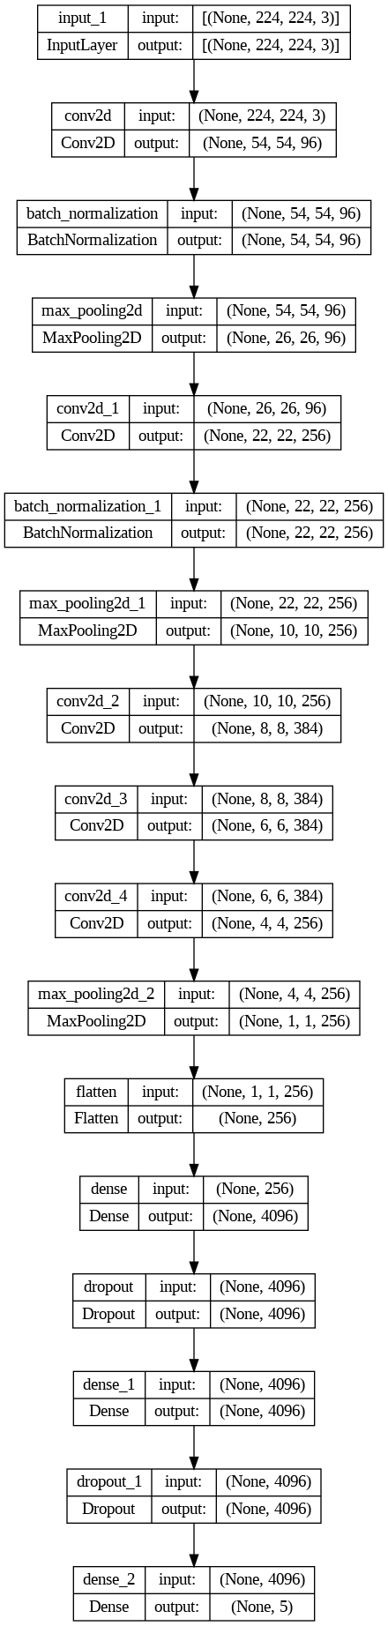
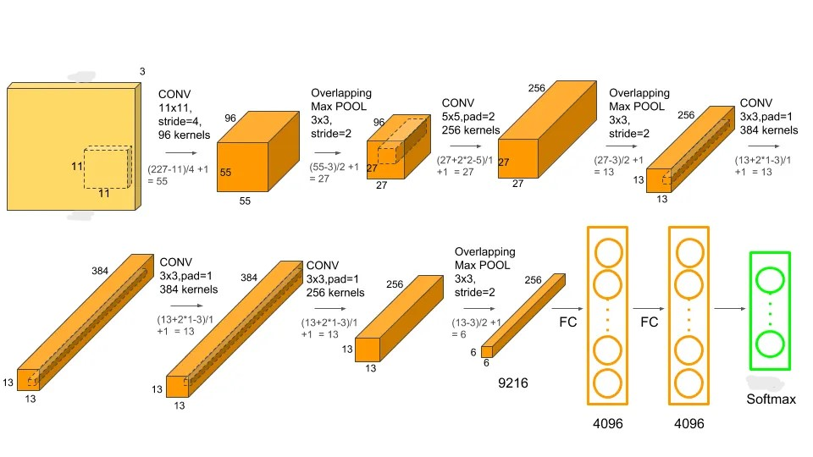
Architecture of AlexNet
Full AlexNet in action
[Note: Here in the diagram below, calculations was done based on input (227,227,3) but in our project we used (224,224,3) which is
Presented on the right]
224
224
5
(Our version)

Slide 13
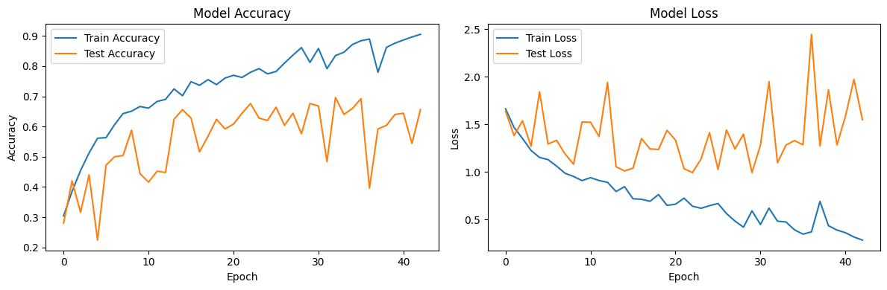
Accuracy of AlexNet
Training Accuracy: 90.52%
Validation (Test) Accuracy: 69.60%

Slide 14
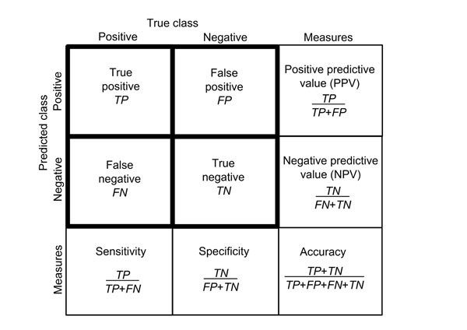
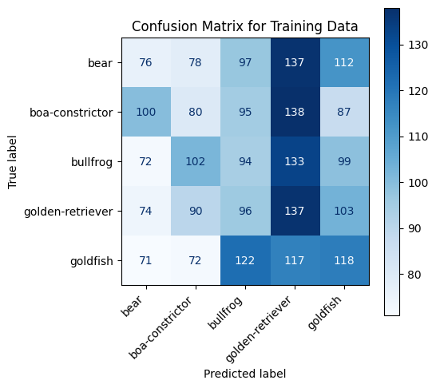
Performance of AlexNet on Train data
Overall Metrics for Training data:
Overall Sensitivity: 0.202
Overall Specificity: 0.8005000000000001
Overall Positive Predictive Value (PPV): 0.20075491378213978
Overall Negative Predictive Value (NPV): 0.8005825202160182
Overall F1 Score: 0.1996799010845609

Slide 15
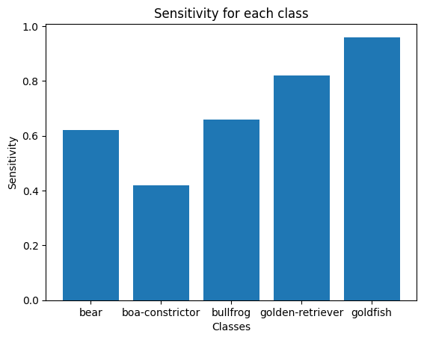
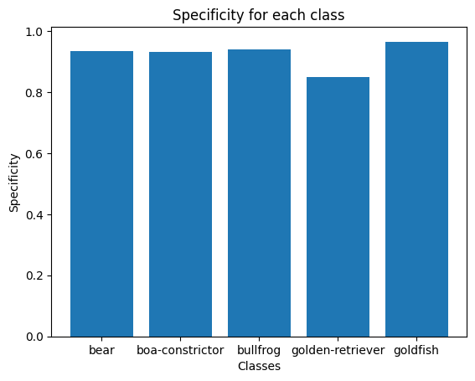
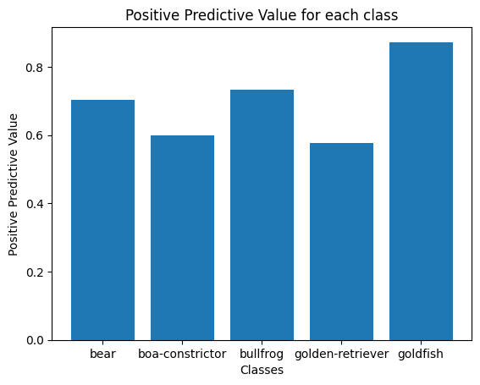
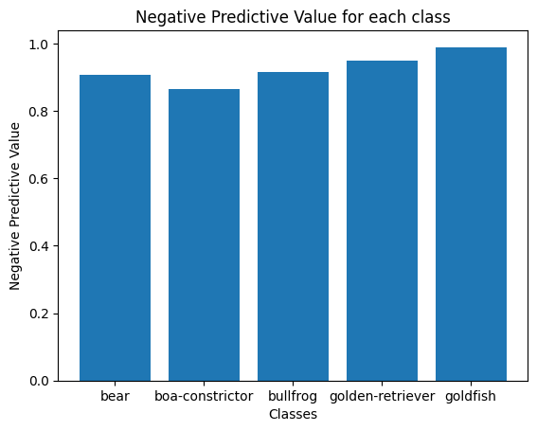
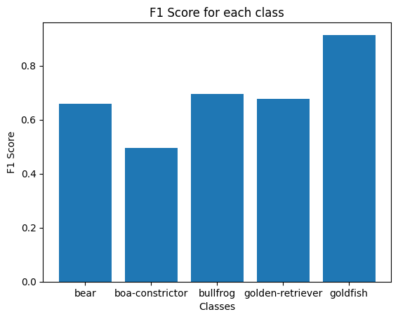
Performance of AlexNet on Train data

Slide 16
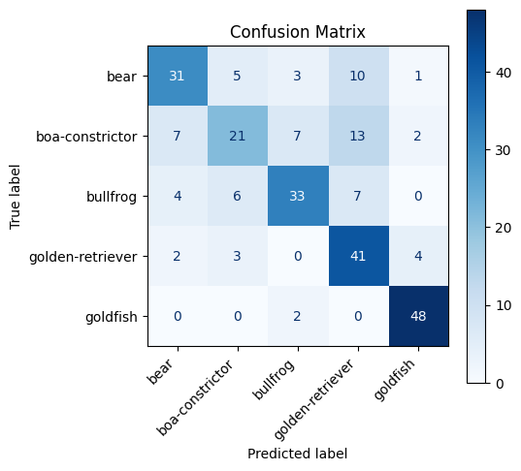
Performance of AlexNet on Test data
Overall Metrics for Testing data:
Overall Sensitivity: 0.696
Overall Specificity: 0.924
Overall Positive Predictive Value (PPV): 0.697614169867691
Overall Negative Predictive Value (NPV): 0.9258841400454777
Overall F1 Score: 0.6880801243896261

Slide 17
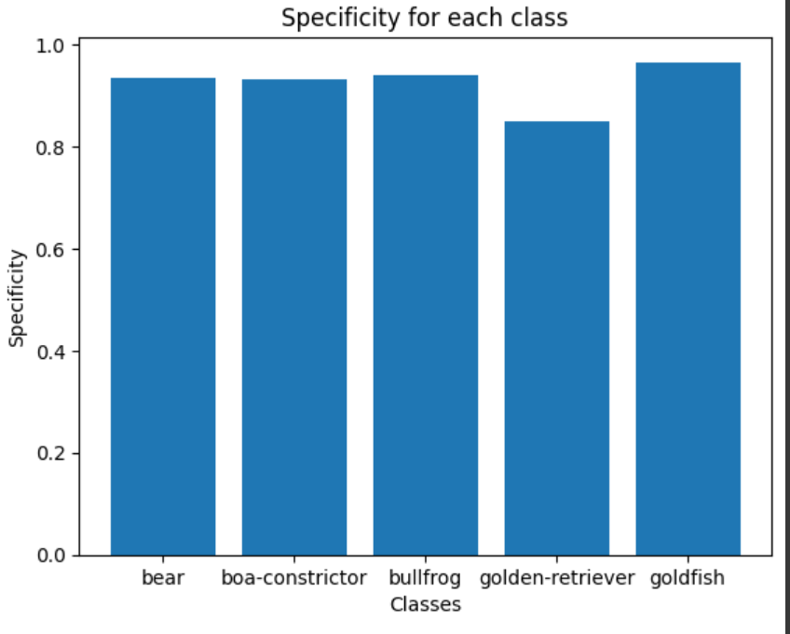
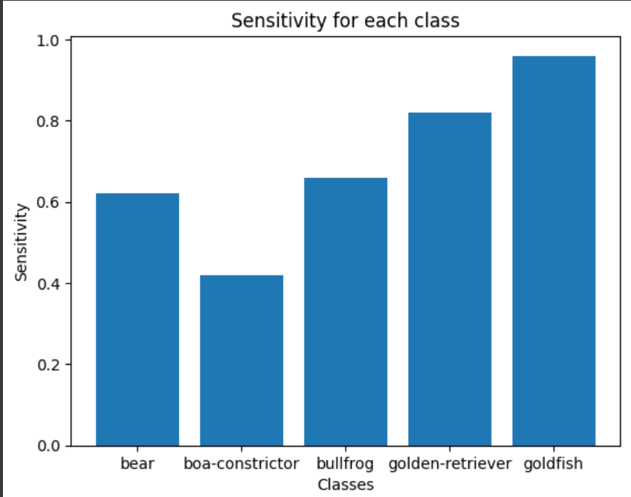

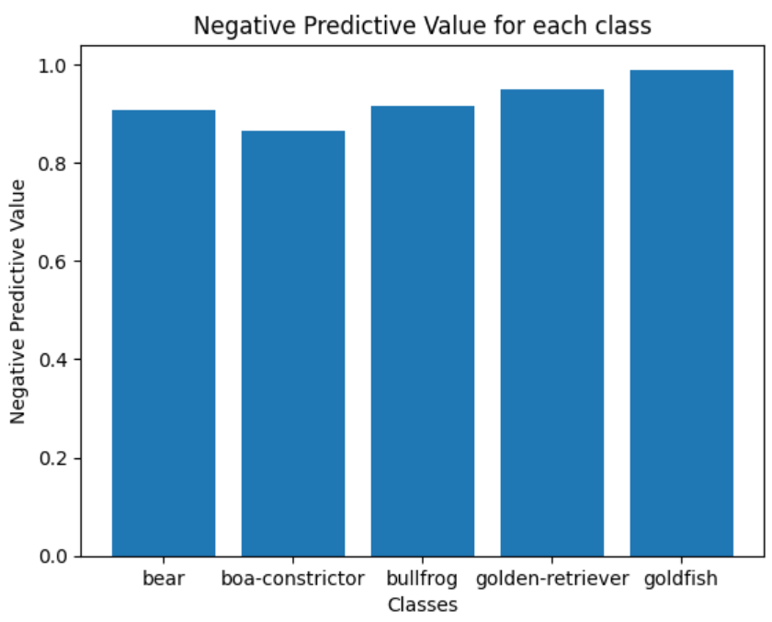
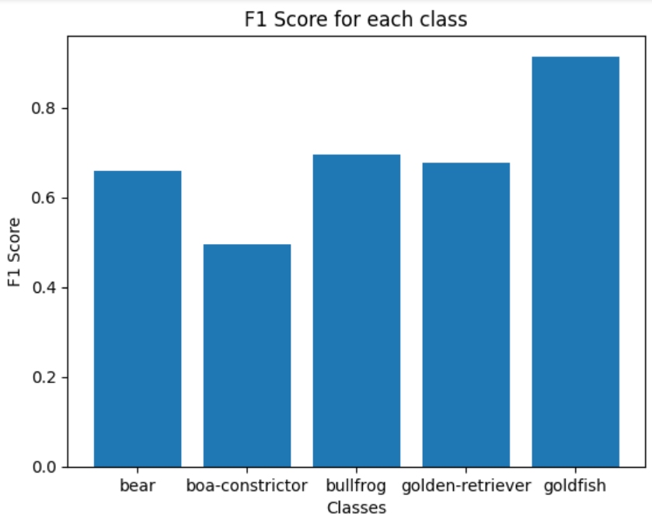
Performance of AlexNet on Test data

Slide 18
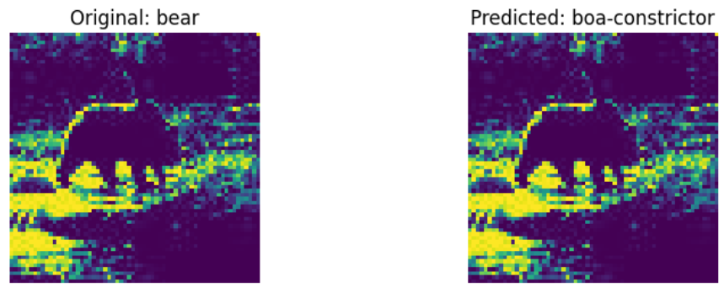
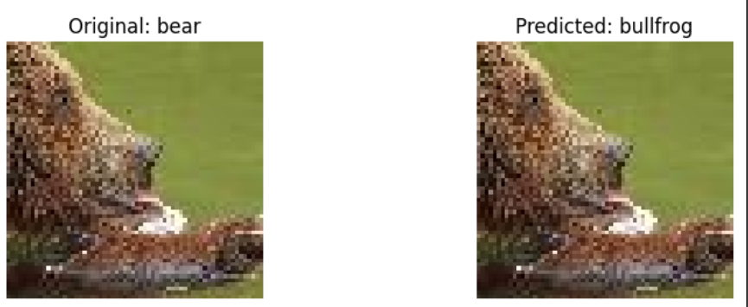
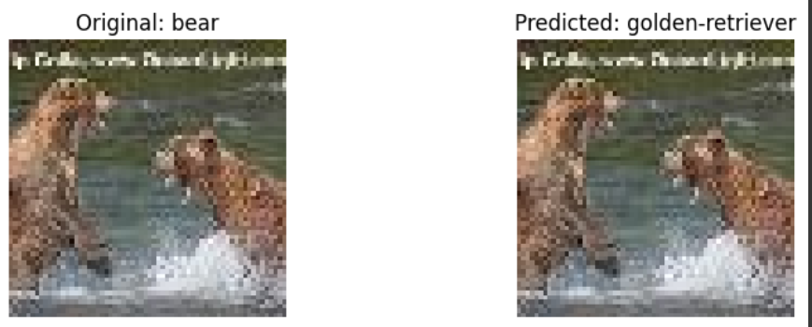
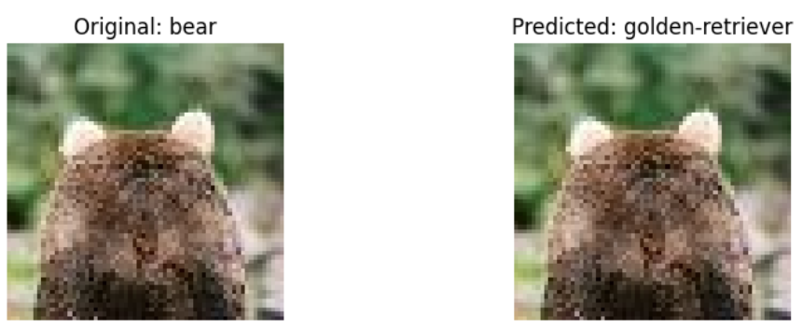
Some Misclassified Images of AlexNet

Slide 19
ResNet-34 part
Kazi Mahathir Rahman
Id -23341066

Slide 20
ResNet-34
ResNet-34 is a variant of the Residual Network (ResNet) architecture, a type of convolutional neural network (CNN) that was introduced by Kaiming He et al. in their 2015 paper "Deep Residual Learning for Image Recognition." The "34" in ResNet-34 refers to the number of layers that have learnable weights, indicating that this model is 34 layers deep.

Slide 21
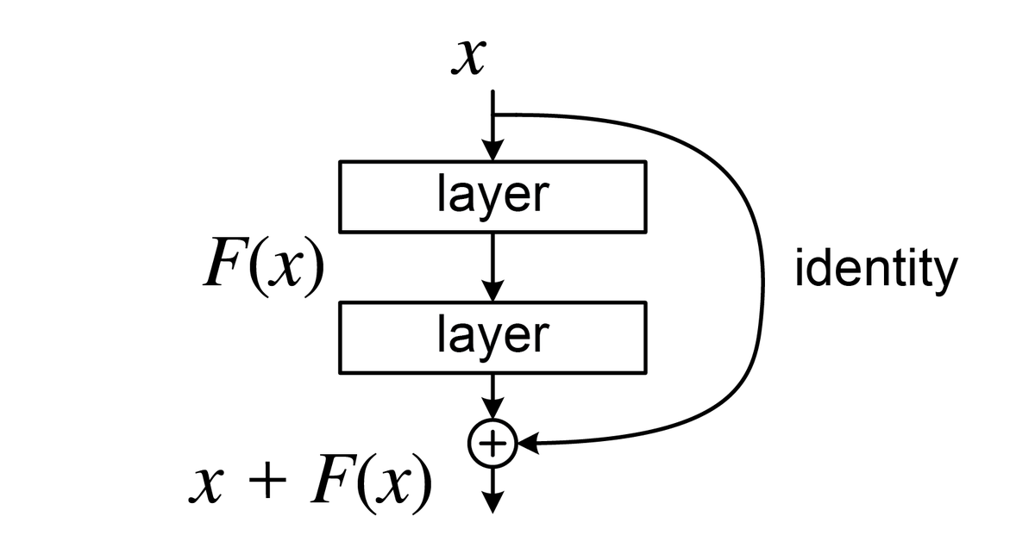
Residual Block
The key innovation in ResNet is the introduction of "skip connections" or "shortcut connections."
These connections allow the input to a layer (or set of layers) to be added to its output, effectively skipping the layers in between.
This approach helps to alleviate the vanishing gradient problem that becomes prominent in deeper networks, as it allows gradients to flow through the network more directly during training.

Slide 22
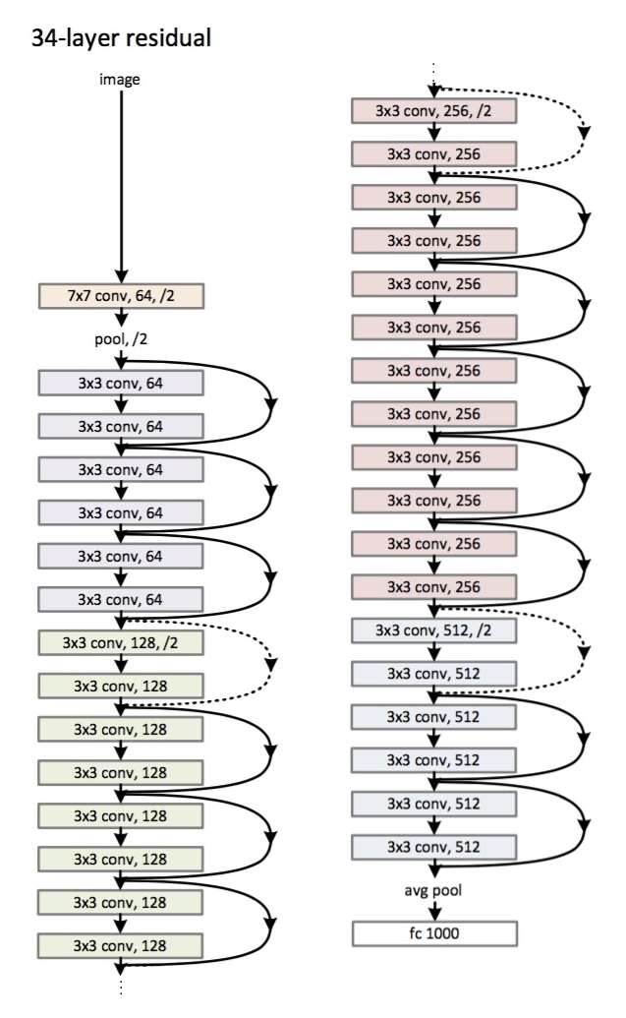
Total 34 layers
First layer- 7*7 conv layer
Second layer - Max Pooling layer
Rest 32 layer are 3*3 conv layer which is made with residual blocks

Slide 23
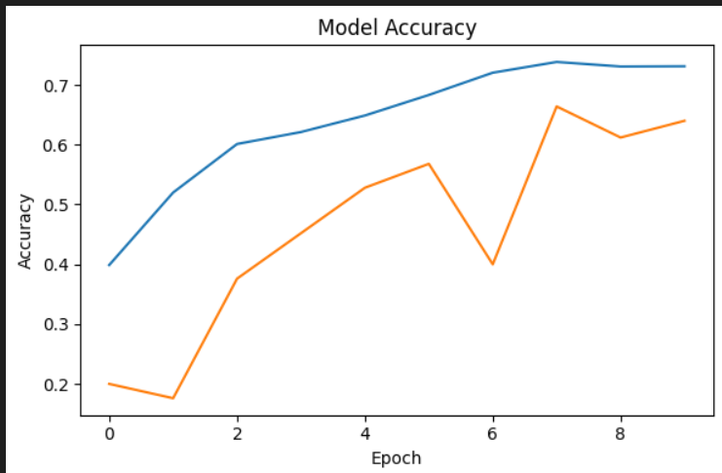
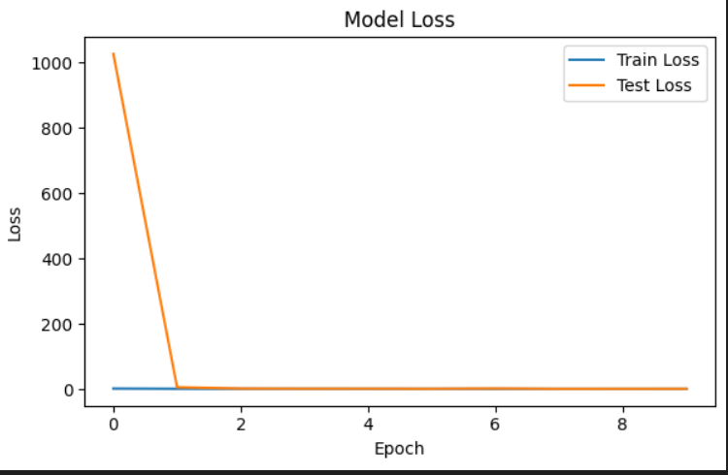
Increasing accuracy and decreasing loss function in each epoch

Slide 24
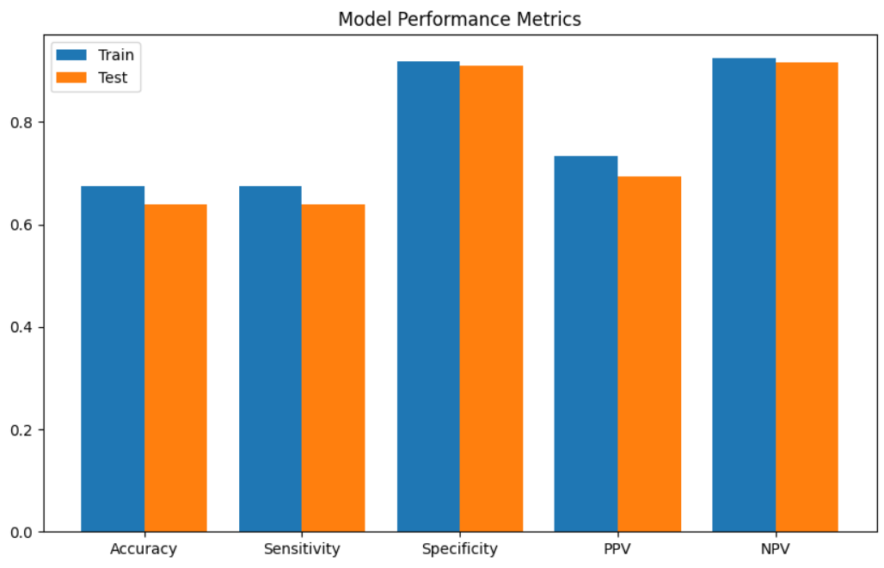
Performance Metrics
Accuracy: 67.44%
Sensitivity: 0.6744
Specificity: 0.9186
PPV: 0.73
NPV: 0.92

Slide 25
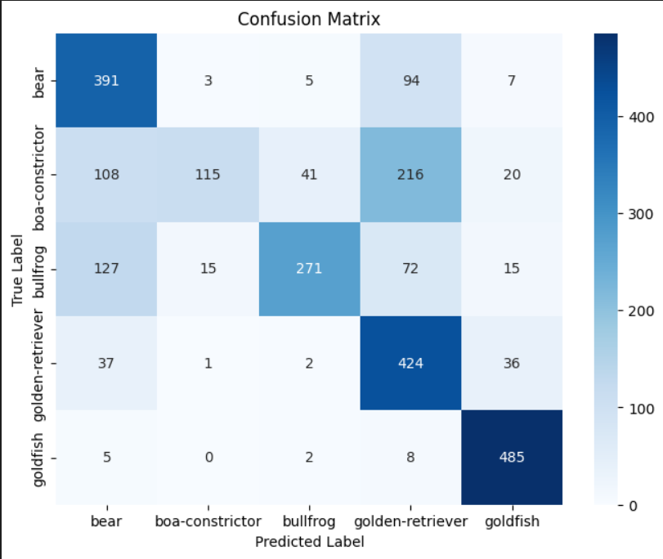
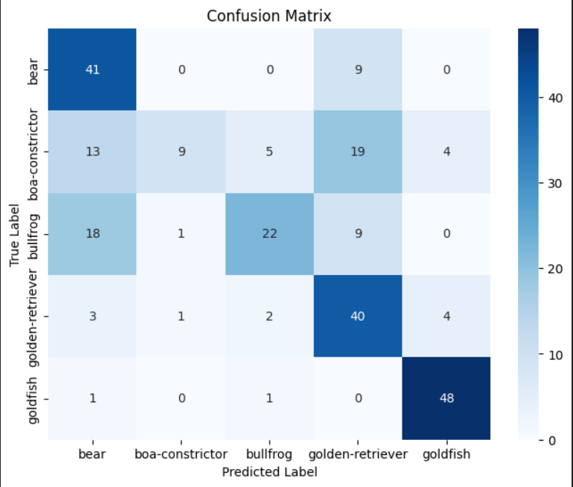
Confusion Matrix for train and test

Slide 26
Inception Net
Md. Abrar Hasan
ID: 23241115
A convolutional neural network (CNN) designed for image classification tasks and developed for the ImageNet Large Scale Visual Recognition Challenges.
Known for using inception modules, blocks of layers designed to learn a combination of local and global features from the input data.
It uses inception module that applies a combination of 1x1, 3x3, and 5x5 convolutions on the input data and utilizes auxiliary classifiers to improve performance.

Slide 27
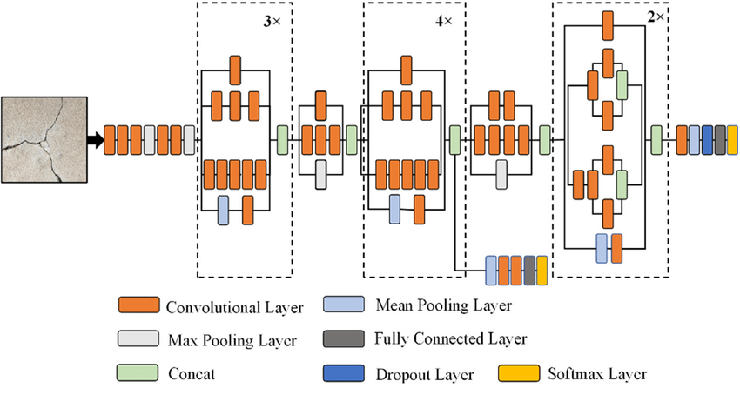
Architecture of Inception Net
(V3 Model)
Md. Abrar Hasan
ID: 23241115

Slide 28
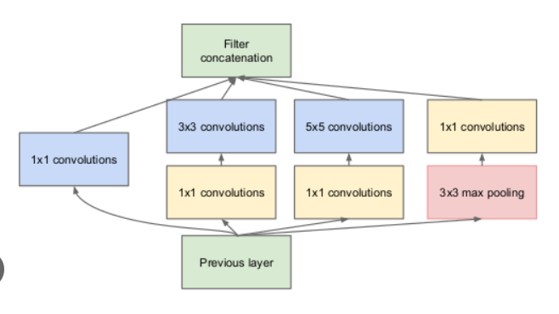
Inception Layer
Md. Abrar Hasan
ID: 23241115

Slide 29
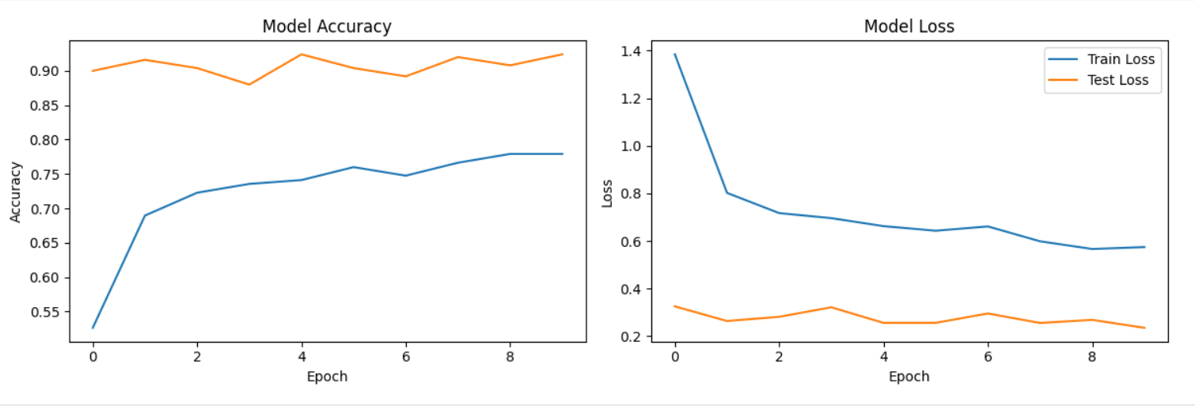
Accuracy of Inception Net
(Epoch-Accuracy Curve)

